Slide 1
Animatronics
Python with Robots Mission 4
Lesson 3 Objectives 8-11

Slide 2

Pre-Mission Warm-Up
In your Mission 4 Lesson 3 log, answer the pre-mission warm-up questions:
What lines of code play a beep?
What lines of code debounce a button?

Slide 3
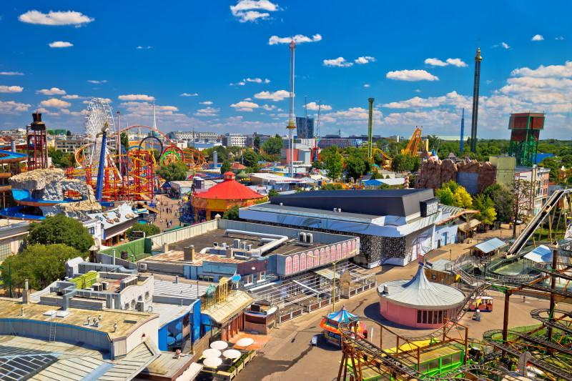
Mission 4: Animatronics
Review: You are hired by a major Theme Park!
Your task is to create a new animatronic robot exhibit.
Gotta write some Python code and get the show running with CodeBot!

Slide 4
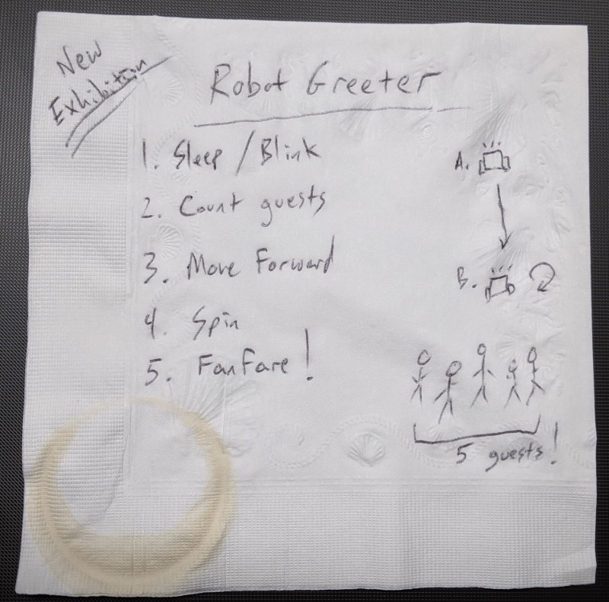
Mission 4: Animatronics
Go back to the notes on the napkin sketch.
Next tasks:
Move forward 2 feet
Spin around in a complete circle with cute robot sounds
Play a fanfare
Goal: Animatronics with movement and sound

Slide 5
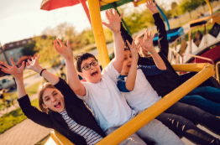
Objective #8: Moving Forward
For this objective, you will
Move the ‘bot forward 2 feet
Spin the ‘bot in a complete circle
Refer to your data from Mission 3 Lesson 3.

Slide 6
Objective #8: Moving Forward
Step 1: Use the data from Mission 3 Lesson 3
What power will you use to move forward?
How many seconds will you move forward to reach 2 feet?
Step 2: Use the data from Mission 3 Lesson 3
What power will you use to spin (one wheel +, one wheel -)?
How many seconds will you spin to go full circle?
Record your data in the mission log.

Slide 7
Objective #8 Activity
DO THIS:
Start a new file – RobotMoves
Type in the code on the next slide.
Watch your indenting!
The code starts with a pause. It will not run until BTN-0 is pressed.
Does the code look familiar?

Slide 8
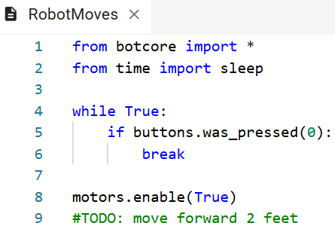
Objective #8 Activity

Slide 9
Objective #8 Activity
DO THIS:
Add code to move the ‘bot forward 2 feet.
Use your data!
Add code to spin the ‘bot a full circle.
Use your data!

Slide 10
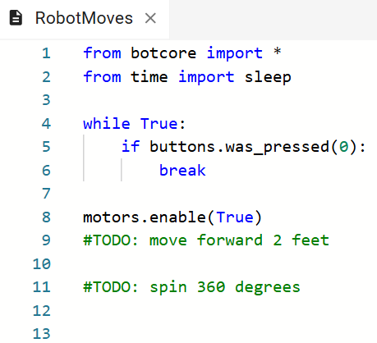
Objective #8 Activity

Slide 11
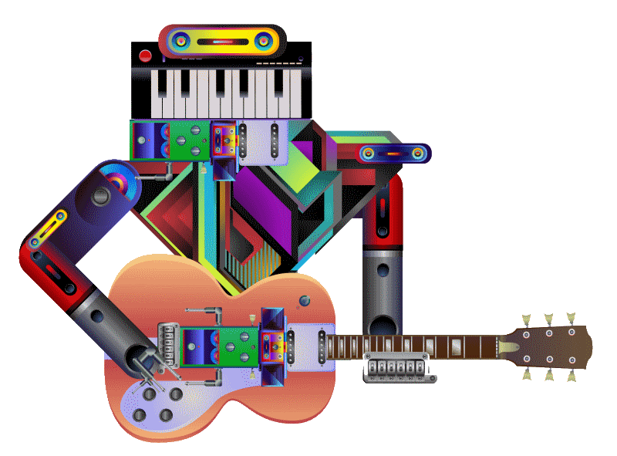
Objective #9: Cute Robot Sounds
It’s time to get your ‘bot sounds ON!
You are still playing with the same simple speaker functions.
But you can control the pitch and tempo by using variables for pitch and delay.
Your Audio Laboratory:
First experiment with a few different sounds.

Slide 12
Objective #9: Cute Robot Sounds
A while loop:
In your programs so far, the while loop has been infinite.
while True:
It continues until you stop the program or break the loop.

Slide 13
Objective #9: Cute Robot Sounds
A while loop doesn’t have to be infinite.
You can give it a specific number of times to run.
For this type of loop, use a control variable.
First, initialize the control variable before the loop starts.
Then start the while loop, and compare the control variable to the specific number.
Increment the control variable inside the while loop.

Slide 14
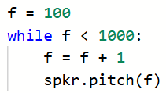
Objective #9: Cute Robot Sounds
while loop example #1:
Control variable | f
Initial value | 0
Specific number | 1000
Increment | f = f + 1

Slide 15

Objective #9: Cute Robot Sounds
while loop example #2:
Control variable | count
Initial value | 0
Specific number | 10
Increment | count = count + 1

Slide 16
Objective #9 Activity
DO THIS:
Look at the while loop examples on your mission log.
Fill the chart for each example.

Slide 17
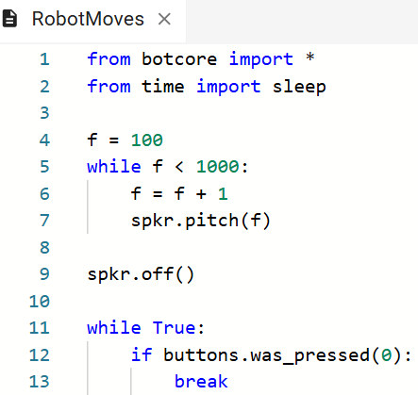
Objective #9 Activity
DO THIS:
Add this code to you program.
The variable f will be used for the pitch frequency.
Run the program.
You do NOT need to press BTN-0.

Slide 18
Objective #9: Cute Robot Sounds
How did it sound?
Interesting, … but …
Pretty quick, right?
Maybe we can stretch it out and make it sound more “robot-like.”
Let’s loop the sound.

Slide 19
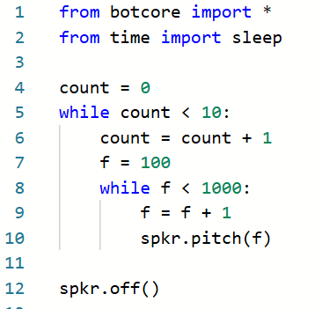
Objective #9 Activity
DO THIS:
Modify the code by adding another loop.
The first loop is “nested” inside the second loop. Make sure to indent!
Run the program.
You do NOT need to press BTN-0.

Slide 20
Objective #10: Really Cute Sounds
Yikes!
That sound will frighten the children!
Um, we were going for cute!
This time we will try for something a little more melodic.
Rather than sweeping the pitch, go for a random beep-boop effect with single tones.

Slide 21

Objective #10: Really Cute Sounds
To make random tones, you need the random module.
This will be an additional import statement.
The random module makes it easy to work with random numbers.
The random module has several functions, but we will use just one: randrange().

Slide 22
Objective #10: Really Cute Sounds
The randrange() function
The function generates an integer.
The function has two parameters: start, stop
new_number = randrange(start, stop)
A parameter is a variable that gets its value from the function call.
The integer will be greater than or equal to the start value, and less than the stop value.

Slide 23
Objective #10 Activity
Random number examples:
DO THIS:
Look at the random number examples on your mission log.
Fill the chart for each example.
Function call | Lowest integer | Highest integer
randrange(1, 10) | 1 | 9
randrange(0, 100) | 0 | 99
randrange(5, 26) | 5 | 25

Slide 24

Objective #10 Activity
DO THIS:
Add an import statement for the random module:

Slide 25
Objective #10 Activity
DO THIS:
Modify the inner loop by:
Picking a random pitch between 100 and 1000 Hz
Playing the pitch for 0.1 seconds.
Try doing this on your own. Then check the next slide.

Slide 26
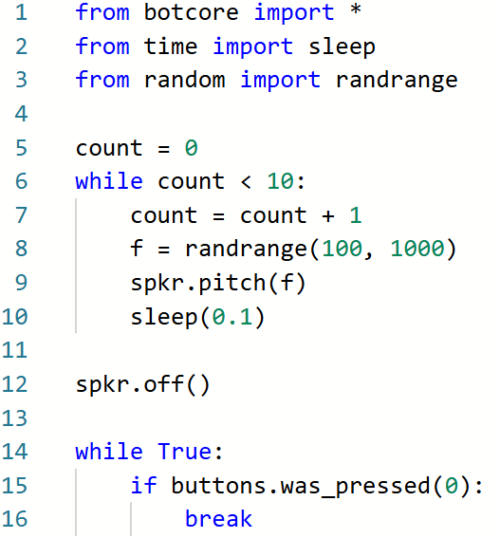
Objective #10 Activity

Slide 27
Objective #10 Activity
DO THIS:
Run the code.
When your code is error-free, do this final step:
Cut your “cute beeps” code from its current position and move it to the bottom of your code.
We will finish the final step with the cute sounds in the next lesson.

Slide 28
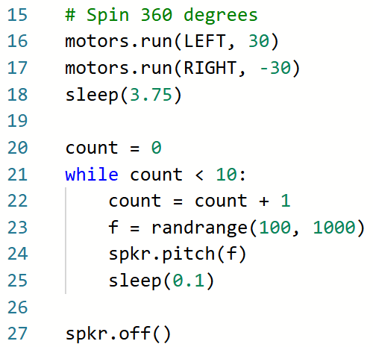
Objective #10 Activity

Slide 29
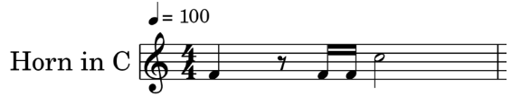
Objective #11: Fanfare!
The final step in this project is to play a Fanfare tune to greet the guests.
A call to the Park’s Director of Bands got you a snippet of the sheet music for CodeBot to play.

Slide 30
Objective #11: Fanfare!
Sheet music is written with notes.
In order to play a note, you need to know the frequency.
For example, F4 is 349 Hz.

Slide 31
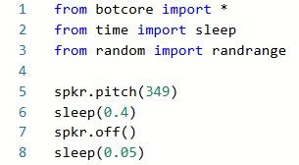
Objective #11: Fanfare!
Let’s play a note.
Add this code to the top of your program for testing.
Play an F4 note for .4 seconds. Then have a small pause before the next note.

Slide 32
Objective #11: Fanfare!
That was NOTE-worthy!
Our fanfare will have four notes.
You could copy and paste the four lines of code for each note to complete the song.
But that is a lot of code!
Instead of copy / paste – create a function!

Slide 33
Objective #11: Fanfare!
A function:
A reusable named chunk of code.
You can run it anytime, and as often as you want.
To run a function, call it by typing the name of the function and ().
note()
If the function has parameters, include them in the ().
A parameter is a variable that gets its value from a function call.
note(freq, duration)

Slide 34
Objective #11: Fanfare!
Define a function to play a single note.
the function note()
The function will take two parameters
freq (for frequency)
duration (for the sleep() function)
Use the parameters in the function
Then test the function by calling it for one note

Slide 35
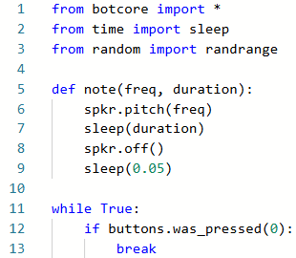
Objective #11 Activity
DO THIS:
Define a function to play a note.

Slide 36
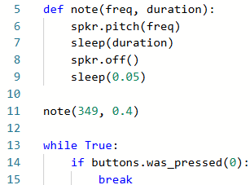
Objective #11 Activity
DO THIS:
Call the function:
The function call is NOT indented!

Slide 37
Extensions
Here are some things to try:
Add additional movement to the robot. It can move again, spin in the opposite direction, etc.
Have the ‘bot return to its starting position after it spins.
Turn on an LED when a note plays.

Slide 38
Post-Mission Reflection
Complete the post-mission reflection in your Mission 4 Lesson 3 Log:
What part of this program was a review from earlier programs?
What part of this program was new?

